Slide 1
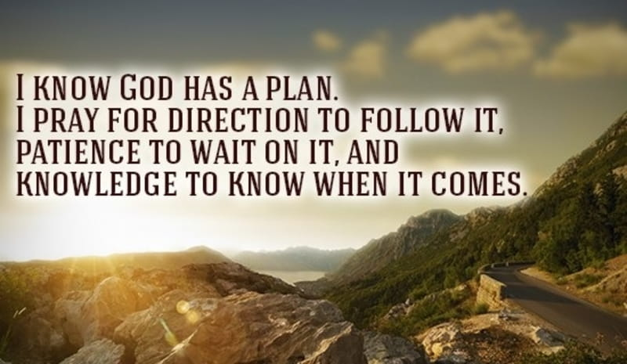


Slide 2

2.) Leadership
This quality is concerned with ensuring that systems and structures are in place and used effectively to ensure that history enjoys a high status, reputation and profile in the school and beyond.

Slide 3
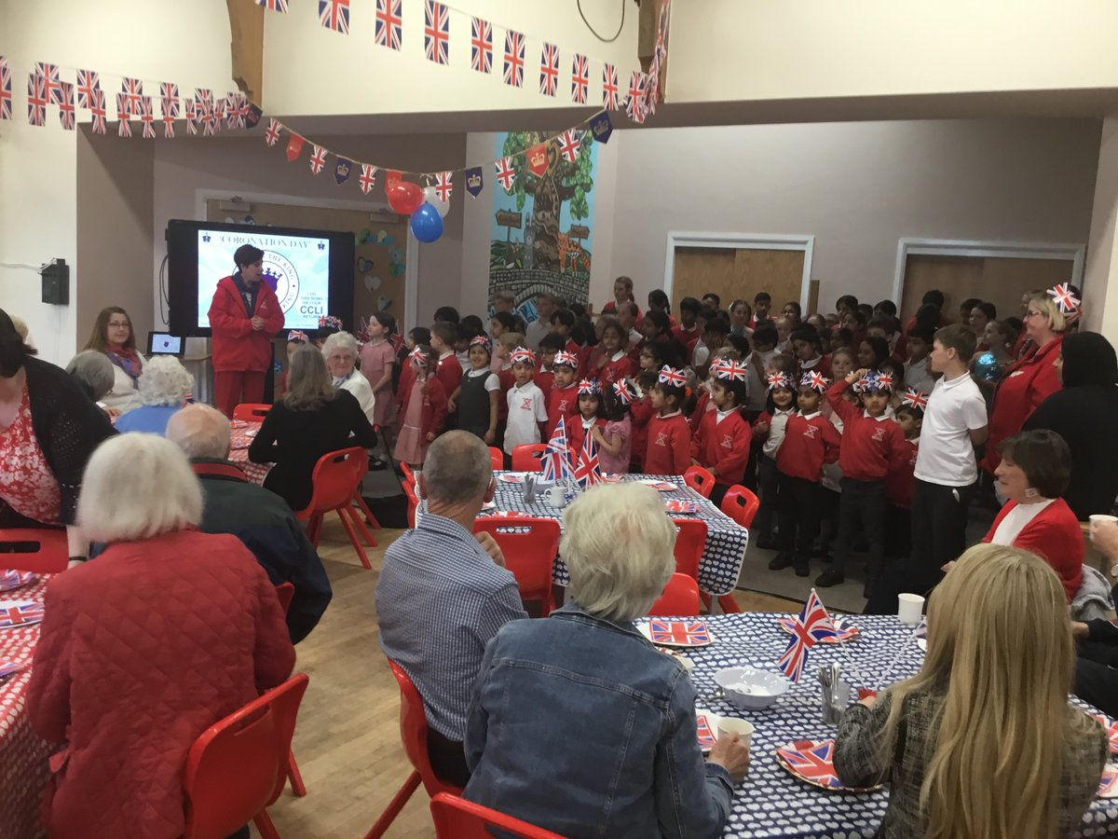

2.1 Show much status does history have in the school?
Evidence 1 – social media – accessible via our school homepage
https://www.balderstoneschool.co.uk
Community tea parties
Next big project– The History of Mellor Brook whole school history/art project. We will be researching the history of the local area.

Slide 4
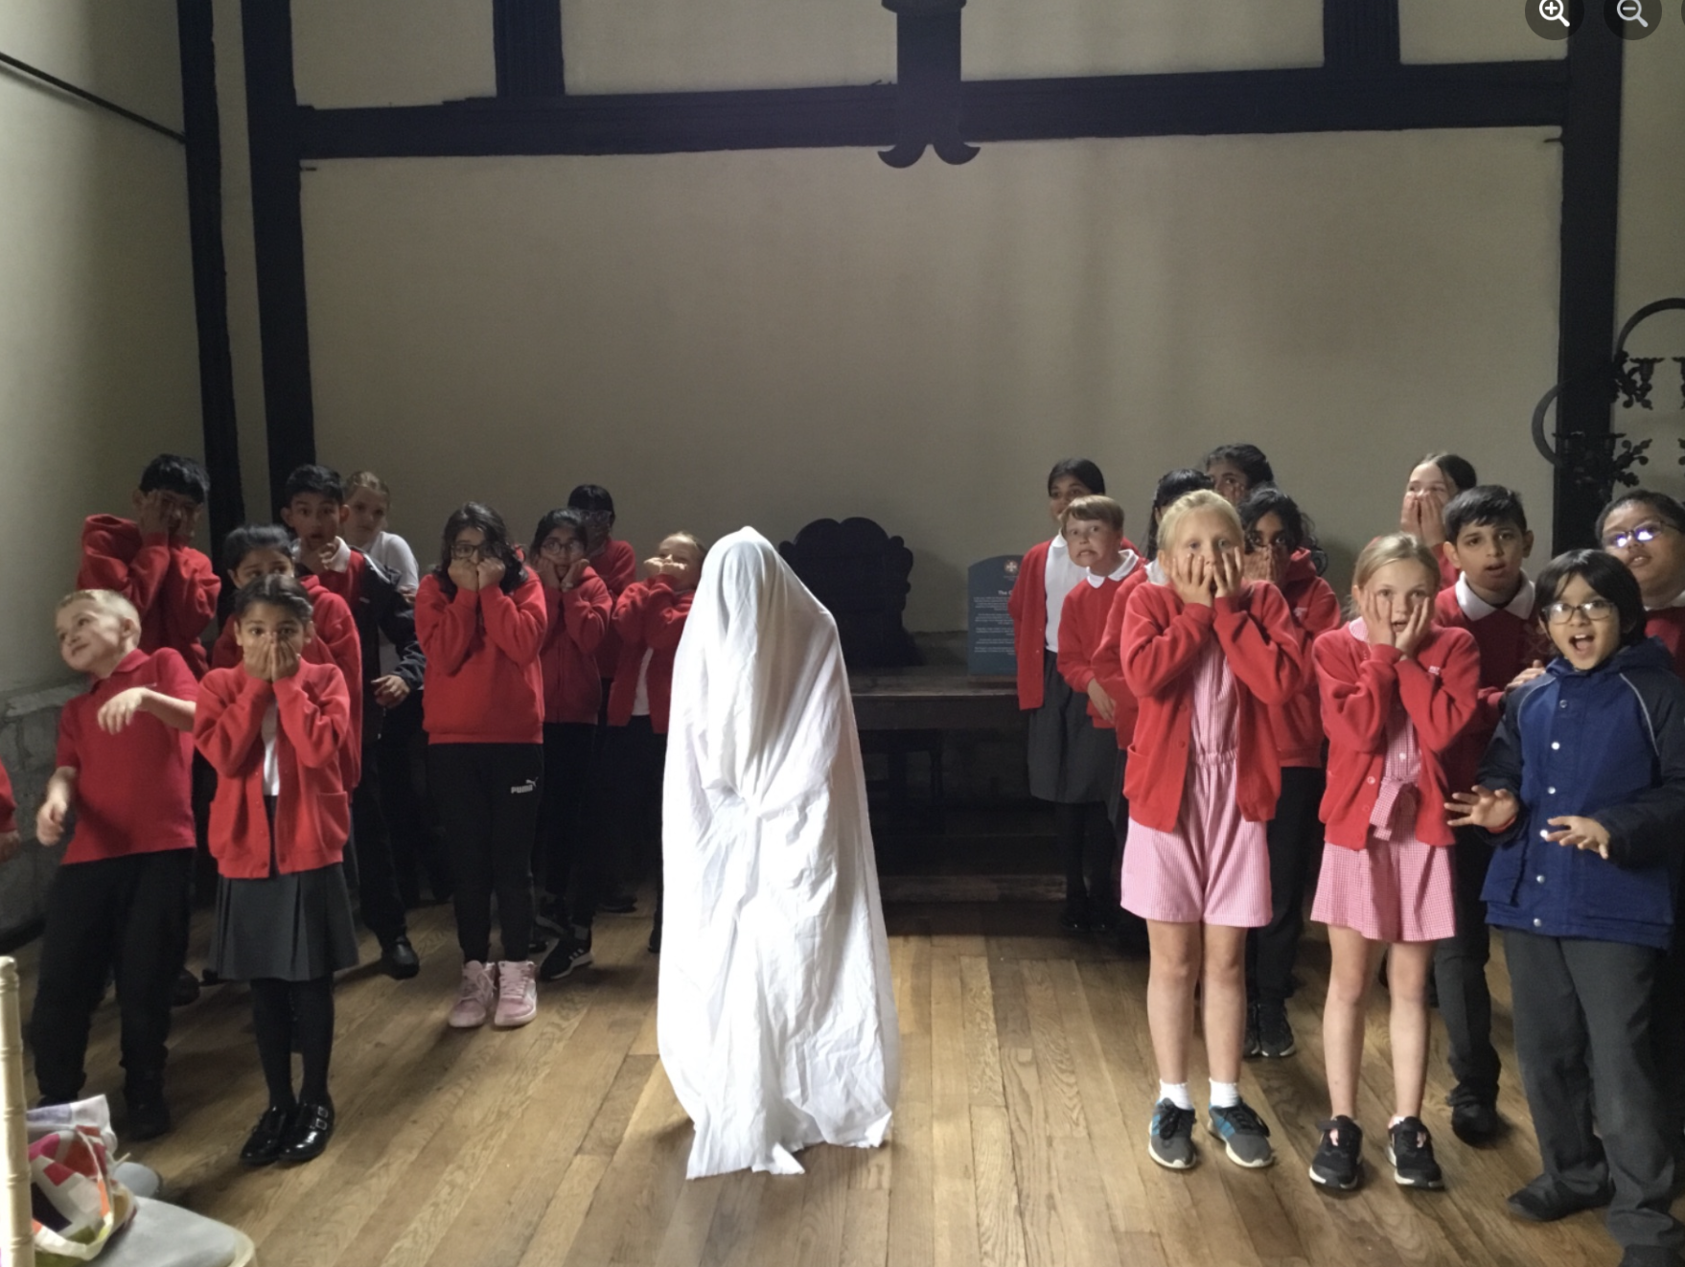
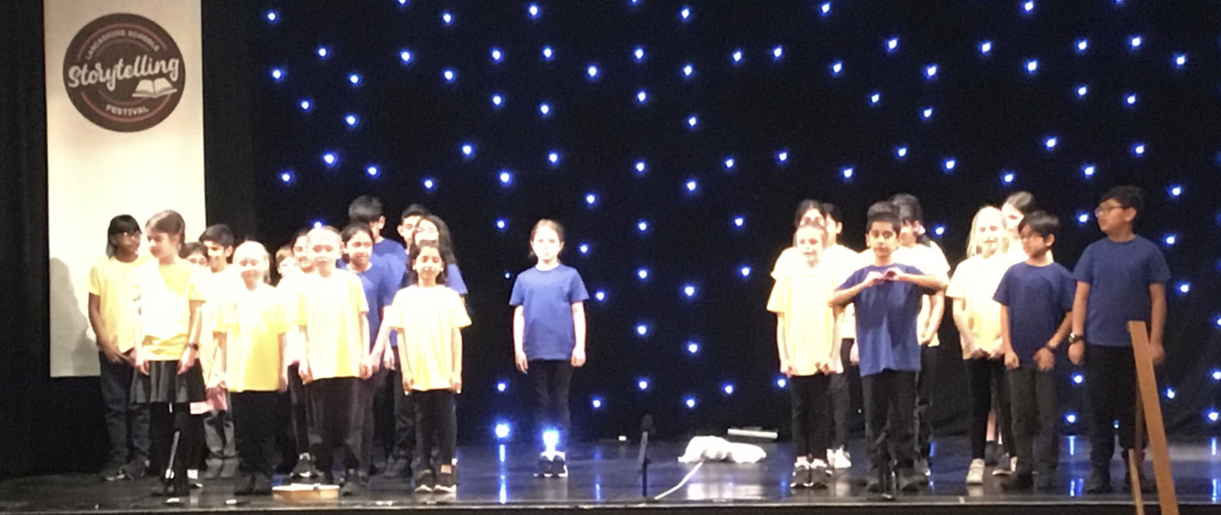
Performing the story of the ‘White Lady’ at Samlesbury Hall.
Evidence 2 – Competitions
We have entered the Local storytelling competition 2 years in a row and reached the finals twice. In the first competition - One of our stories had to be local – we chose the story of ‘ the white lady’ from Samlesbury Hall (local historical building) . We arranged for the children to perform their story at Samlesbury Hall so that parents could see it too. The children said it was atmospheric and ‘special’ to perform the legendary story at the place where it happened.
Performing the story of the ‘White Lady’ at the Lancashire Storytelling Festival.

Slide 5
2.2: How is history organised, administered and managed?
Kate Turner History Champion – informs staff of the focus for the year
History has also been part of her Appraisal targets.
2022-23 focused on vocabulary.
The History Champion together with the History Governor meet to talk to the children and book look.
The findings are reported back to staff at staff meetings
The next few slides are taken from Mrs Smith’s Governor Report.
Focus for 2023-24 is sources of evidence and continuing to make links
The History champion with the History Heroes team are always looking for ways forward/ improving.

Slide 6
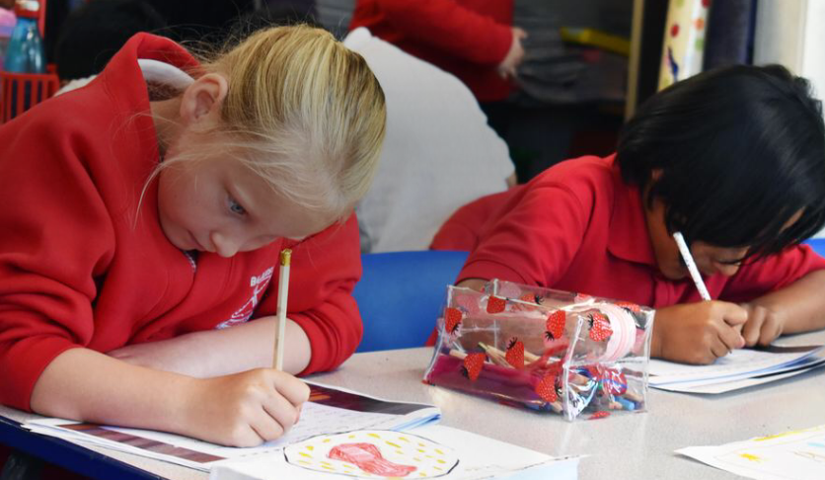
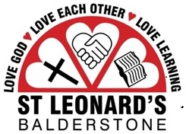
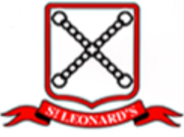
Governor Review
Subject: History
Janet Smith, Parent Governor
06 December 2022

Slide 7
Subject Review: History
AGENDA
Contributors
Purpose of Review
Content of Review
Outcomes/Findings
Best Practice review/Areas identified for improvement
Next steps
Conclusions
Summary

Slide 8
Subject Review: History
1
Contributors

Slide 9
Subject Review: History Background
Review undertaken by:
Mrs Janet Smith, Parent Governor, History lead
with the assistance of:
Mrs Kate Turner, History Lead, Balderstone St. Leonard’s

Slide 10
Subject Review: History
2
Purpose of Review

Slide 11
Subject Review: History Purpose of Review
To ensure that the teaching plan for history aligns with the requirements of the national curriculum
To ensure that history curriculum map take account of pupils with a variety of learning needs, including SEND and pupil premium students
To ascertain whether a process is place for carrying out regular best practice reviews, in order to ensure that the approach, materials and tools are up to date and take account of any changes
To identify any additional enrichment taking place to increase engagement / enthusiasm and embed knowledge
To obtain an idea of student engagement levels as a guide to the expected level of learning/uptake

Slide 12
Subject Review: History
4
Content of Review

Slide 13
Subject Review: History Content of Review
Reviewed the curriculum and progression map against the National Curriculum to establish whether these are aligned and comprehensive
Reviewed the choice of historical events to establish whether these were appropriate for Balderstone St. Leonard’s taking account of the geography, demographic, and local amenities and resources
Reviewed a sample of student workbooks from all school year groups
Sample to include the workbooks of students of all ranges of ability, including SEND and pupil premium students
Reviewed a sample of teachers’ floor books
Carried out face to face interviews with students from all year groups, including SEND students (NB students from years 3/4 were at swimming on the day and were met with on a separate occasion)

Slide 14
2.3 How well does the school evaluate performance in history?
The children are our driving force!
History Heroes keep us on our toes – the children want to learn - they want to teach - and next steps is to take this love of HISTORY out beyond our school into other schools.

Slide 15
This slide speaks volumes – children writing letters to be a History Hero!

Slide 16
2.4 How well does the school support the ability of staff to deliver effective history?

Slide 17
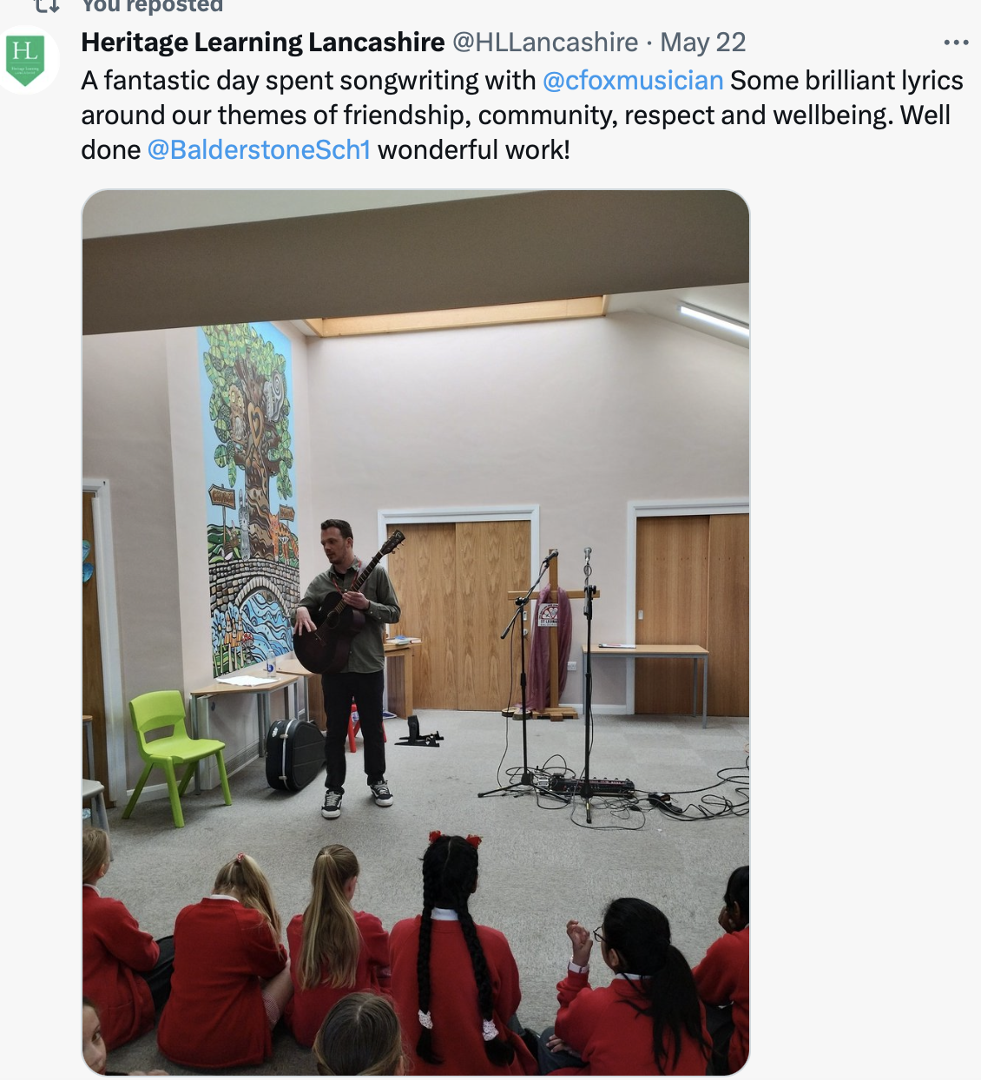
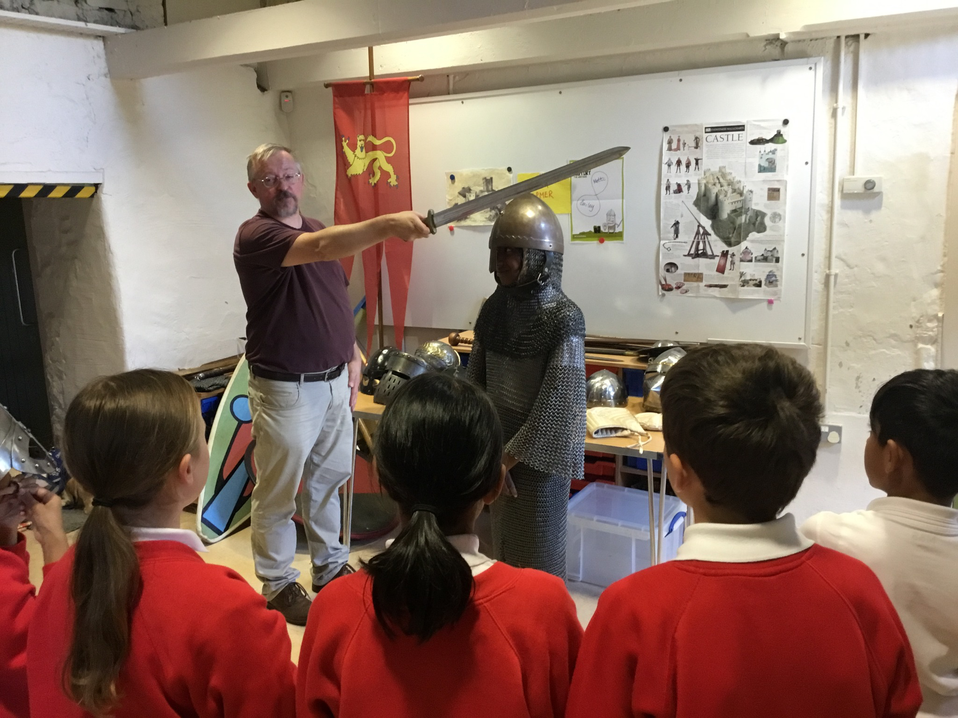
Staff learn from the educators on our History trips.

Slide 18
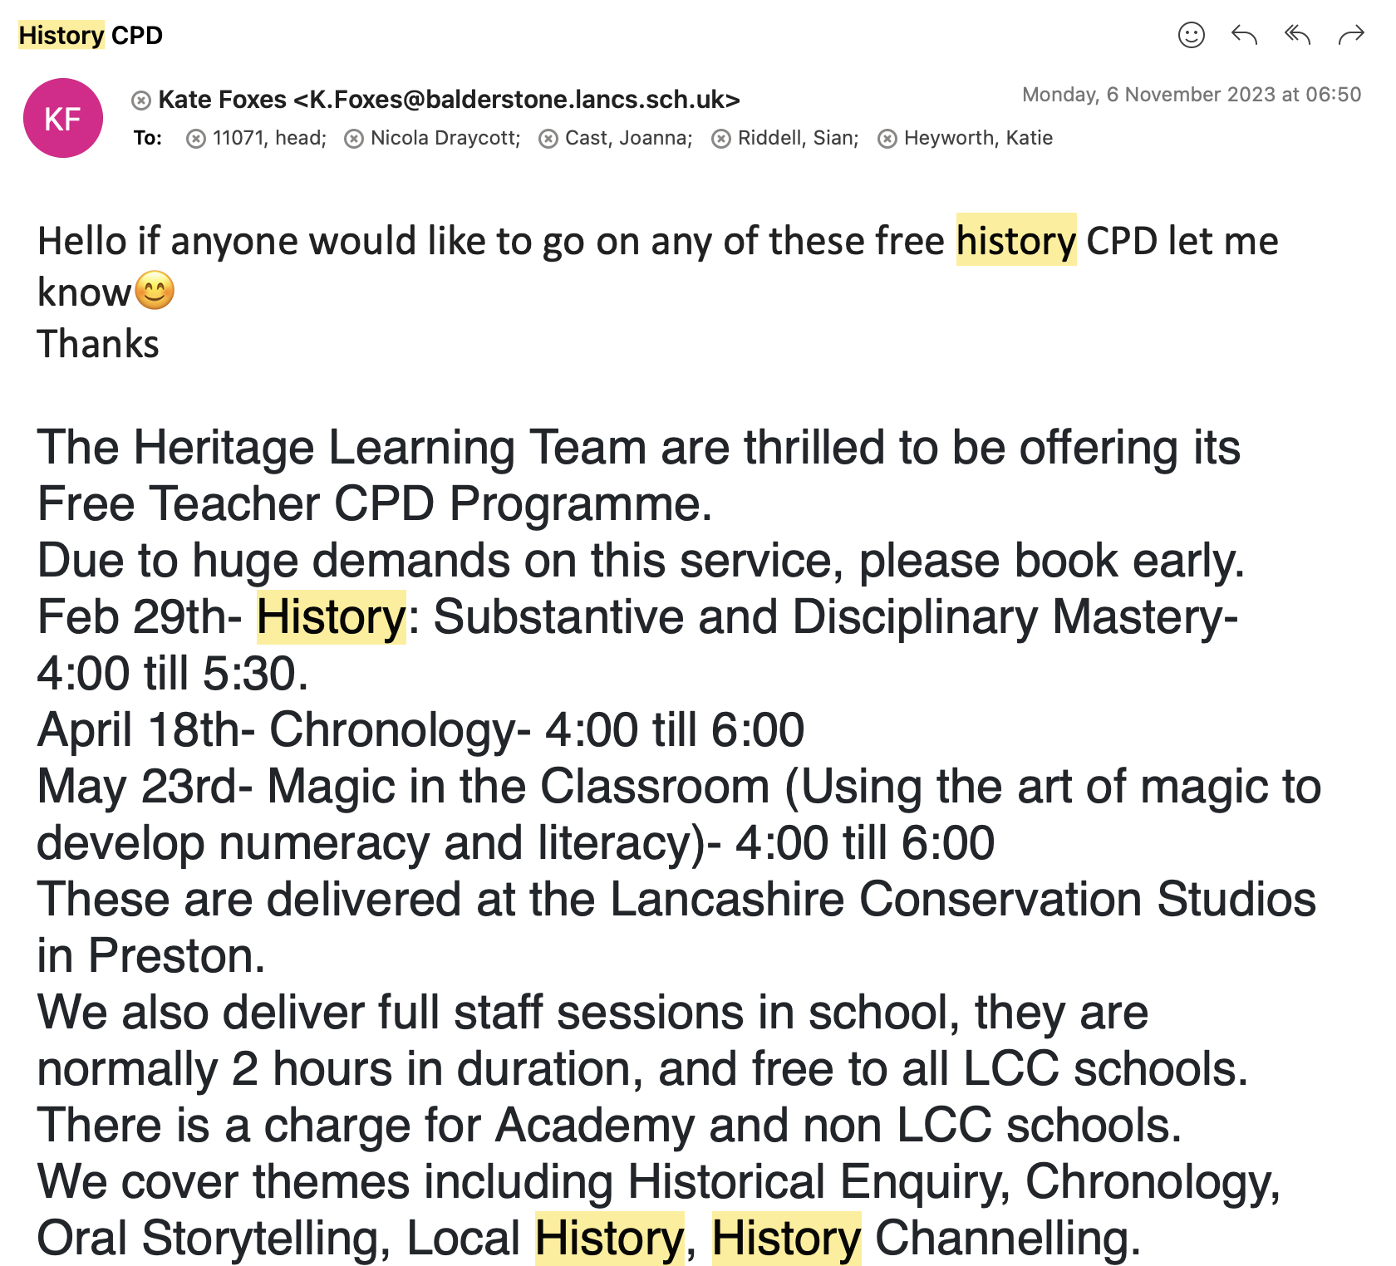
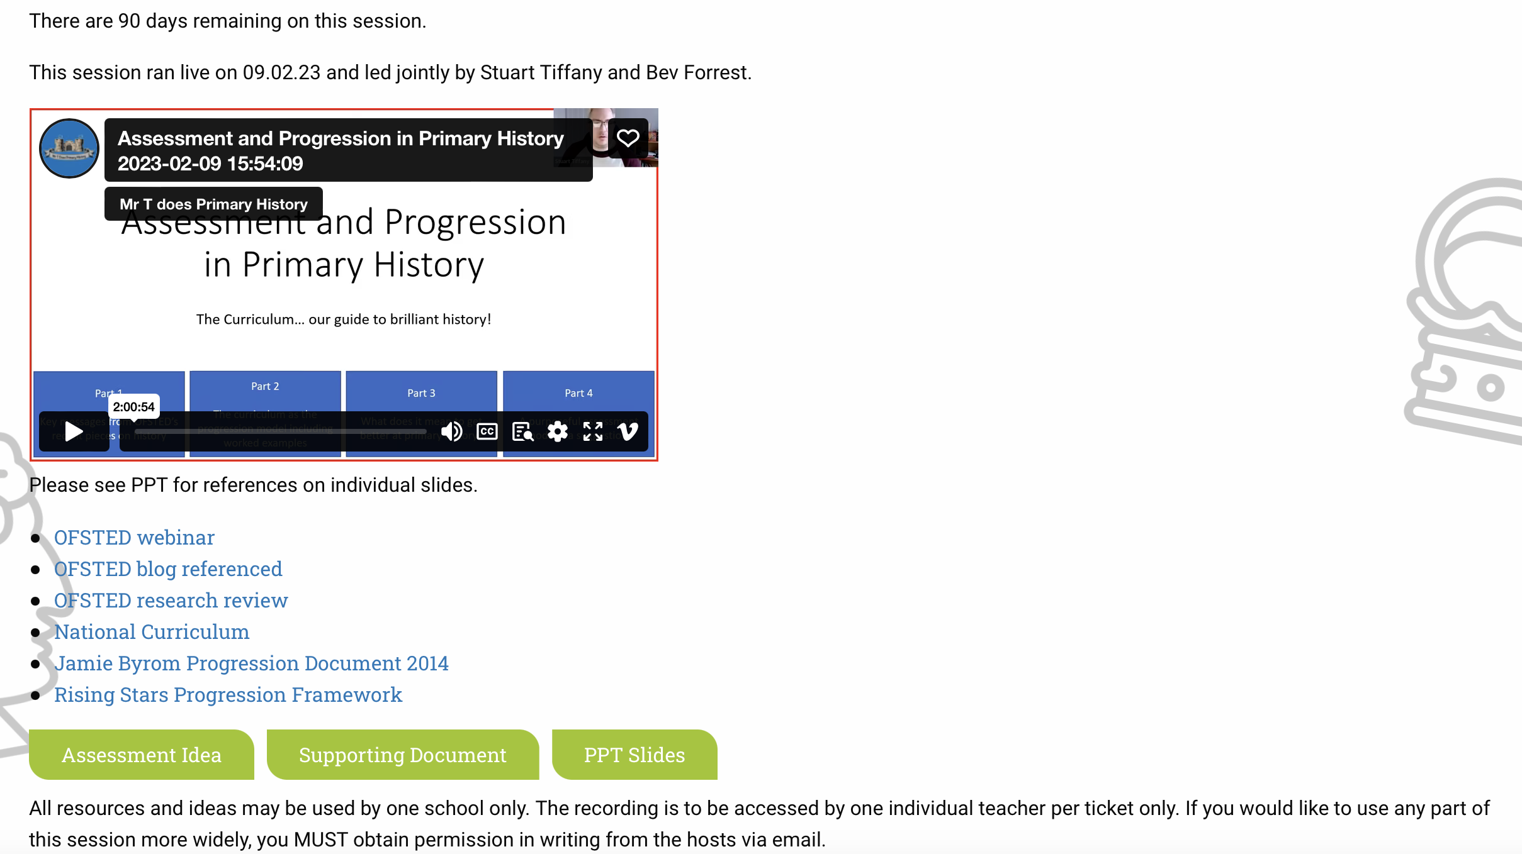
History champion accesses Mr T does History - assessment CPD
ALL STAFF HAVE LOGINS FOR HISTORICAL ASSOCIATION
Staff are updated with CPD ideas.

